Slide 1



Rigorous estimates of turbulent
dissipation in shear flows
Charles R. Doering
Department of Physics,
Department of Mathematics, and
Center for the Study of Complex Systems
University of Michigan, Ann Arbor, MI 48019 USA
Charlie
.______

Slide 17
C_{f}
.

Slide 21
Theorem: C_{f} ≤ const
C_{f}

Slide 22
Open problem …
A monetary prize problem …
Exponentially large prize problem:
Can you prove that the steady laminar
flow has minimum dissipation for
this shear-with-suction setup?
Clay prize problem = $10⁶
Charlie’s prize problem = $2⁶
($64 question!)

Slide 24
Curious open problem …
Is it possible?

Slide 25
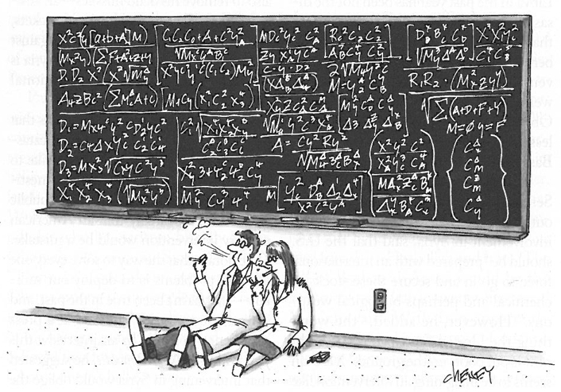
Thanks for your attention!

